Slide 2
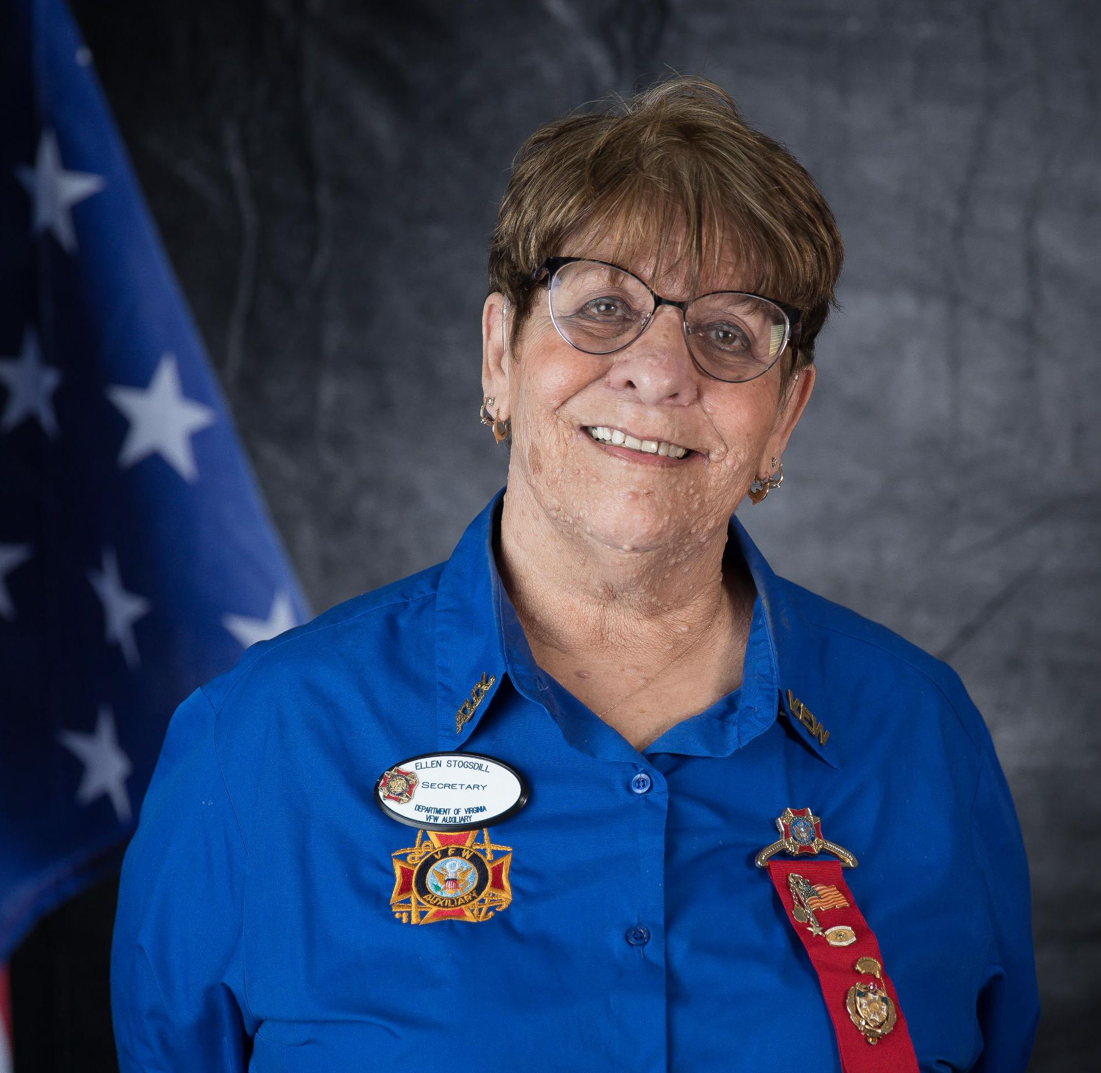
Secretary Training
Ellen Stogsdill
Department Secretary - Post 392

Slide 3


SECRETARY
Secretary definition, a person, usually an official, who is in charge of the records, correspondence, minutes of meetings, and related affairs of an organization, company, association, auxiliary, etc.

Slide 4
DELEGATES AND ALTERNATES
Sec. 301—Eligibility
  Any member in good standing in their respective Auxiliary shall be eligible for election as a County Council, District, Department or National Delegate.
  Delegates and Alternates shall serve for one (1) full year from election to election.
  Delegates and Alternates shall function at the Convention and any Department Meeting where voting is called for following their election.
  Delegates and Alternates elected to County Council, District, Department and National Conventions shall be recognized only when Auxiliaries have conformed to the National Bylaws.

Slide 5
Department Delegates
Sec. 304—Department Meetings and Convention
  Delegates and Alternates to the Departments shall be elected at a regular meeting of the Auxiliary held not less than thirty (30) calendar days prior to the Department Convention:
  One (1) Delegate and one (1) Alternate for each thirty (30) members or fraction thereof in good standing in the Auxiliary at the time of the election of Delegates.
  The Auxiliary Secretary shall send the names of the Delegates and Alternates to the Department Secretary prior to the Department Convention

Slide 6

Department Delegates/ Alternative for June 2021 Convention
This is to certify that the Delegates and Alternates listed below were duly elected on April1, 2021, with the total VFW Auxiliary membership of 500 divided by 30 = 16.66 = 17 members to represent our VFW Auxiliary No.25, District 14 in Elvis, Virginia at the upcoming Department of Virginia Convention.
Do I figure how many Delegates and Alternates my Auxiliaries has?

Slide 7

2021 Department Delegates/Alternatives
This form will be available on our Website and in Communications, and emailed to Auxiliaries Sectretary by 3-1-2021 Please email it to ellenstogsdill@cox.net After elections of Delegates for the June Convention
This sheet will be used for your Auxiliary to be able to vote at all Department Meeting from election FROM April – April.
NO SHEET, NO VOTE AT DEPARMENT AT DEPARTMENT MEETING.
Please DO NOT just list the members that will be attending the Meeting.

Slide 8
District Delegates for District Convention
Sec. 303—District Meetings and Convention
  Delegates and Alternates to Districts shall be elected at a regular meeting of the Auxiliary held not less than thirty (30) calendar days prior to theDistrict Convention at which District Officers are to be elected
  One (1) Delegate and one (1) Alternate for each fifteen (15) members or fraction thereof in good standing in the Auxiliary at the time of the election of Delegates.
  The Auxiliary Secretary shall send the names of the Delegates and Alternates to the District Secretary prior to the District Convention

Slide 9
District Delegates/ Alternative for District Convention
This is to certify that the Delegates and Alternates listed below were duly elected on April1, 2020, with the total VFW Auxiliary membership of 500 divided by 15 = 33.33 = 34 members to represent our VFW Auxiliary No.25, District 14 in Elvis, Virginia at the upcoming Department of Virginia Convention.
Do I figure how many Delegates and Alternates my Auxiliaries has?

Slide 10
District Delegates and Alternative for District Convention
This form will be available on our Website, Communication and email to all Auxiliaries Secretaries by 3-1-2021 Please email it to your
DISTRICT SECRETARY
BEFORE THE START OF DISTRICT CONVENTION
If the District Secretary does not receive this form your Auxiliary does not have a vote at the District Meeting for business at your District Meeting.

Slide 11
Sec. 806 Installation of Officers
Sec. 806A—Auxiliary:
Auxiliary Officers shall be installed in their respective offices not more than sixty (60) calendar days prior to the convening of the Department Convention.
But shall not assume their duties until the Department President is installed.
Sec. 806C—District:
The District Officers shall be installed before the adjournment of the meeting at which elected.
But shall not assume the duties of office until the installation of the District President as a member Department Council of Administration.
Sec. 806D—Department
The Department Officers shall be installed before the adjournment of the Convention at which they were elected.
Unless otherwise authorized by the National President.
They shall enter upon the duties of their respective offices immediately after adjournment of the meeting at which they were installed.

Slide 12

WHO FILE THE INSTALLATION REPORT?
Immediately following installation of officers, the District and Auxiliary Secretary must submit the installation report to the National Secretary and the Department Secretary within the appropriate time frame either in Malta or sending to the Department Secretary for the Malta entry to be completed.
National provided the correct Installation Report to be used.

Slide 13
Sectaries Duties:
The Secretary shall keep in books or files:
The current “Podium Edition Bylaws and Ritual”
A record of all the minutes of each meeting of the Auxiliary
The manner in which the minutes of the Auxiliary meetings are read, printed and/or distributed shall be at the discretion of the Auxiliary by vote of the membership.
It is permissible to secure typed or computer-generated minutes in the permanent book.
Or insert in a three- ring binder or clip folder

Slide 14
Sectaries Duties:
Each minute page shall be numbered consecutively and provide a space for the Trustees to initial at audit.
The Treasurers reports and the audit reports must be incorporated in the minutes.
Corrections shall be made in the margins.
Shall attend to all matters of correspondence under the direction of the President.
A General or Special-Order file for the current year in which shall be preserved all orders and circulars issued by the National and Department Headquarters.
In the order in which they are received

Slide 15
Sectaries Duties:
A letter file in which shall be kept all correspondence of the Auxiliary.
General correspondence to be retained for one (1) year.
Policy and rulings are to be maintained in a permanent file.
All communications from National or Department Officers are official and shall be read at a meeting before being filed for reference.
All communications of any nature whatsoever intended for the consideration of the National Body shall be signed by the President and forwarded by the Secretary of the Auxiliary to the Department President.
All official communications to National Officers from the Auxiliary must also be forwarded through channels.

Slide 16
Sectaries Duties:
Shall notify orally or in writing all newly elected members.
Shall under the direction of the President, prepare all reports required of them.
Shall transfer to their successor, without delay, all papers, books and other property of the Auxiliary in their possession.
Shall see that all installation reports have been submitted to Secretaries required to receive them within the appropriate time frame.
To perform such other duties as are usually incident to such office.
Shall notify all required offices the names and addresses of elected and appointed Officers

Slide 17
Sec. 812A—Auxiliary Secretary
The Auxiliary Secretary shall
  Maintain a roll of deceased members with the date of death.
  Input or transmit the names of the Delegates and Alternates to Secretaries required to receive them within thirty (30) calendar days of election.
  Immediately following installation, submit the installation report to the National Secretary and the Department Secretary within the appropriate time frame.

Slide 18

Sec. 812—Secretary, Duties of (All Levels)
All communications from National or Department Officers are OFFICIAL and shall be read or printed and distributed by the Auxiliary Secretary at a meeting before being filed for reference.
We have had several complaints that Secretaries are not reading or printing the Official communications from National or Department at Auxiliaries Meeting.
If this is not being done at your monthly meeting, your Auxiliary is not in compliance with the by-laws!
An Auxiliary could be put on Suspension for training for the Secretary failure to comply with this by-law.
Auxiliary must VOTE to print the National/Department Communication and Minutes to be hand out at the meeting. Minutes should be given to the members to read and approved.
Secretary should note in the Minutes that they was approved as printed or approved with the following corrections.

Slide 19

https://vfwauxiliary.org/online-auxiliary-academy/
Secretary Instruction
  Installation Report Form for Auxiliaries/Districts/County Councils (Fillable pdf)
  Form to Submit Delegates and Alternates for National Convention (Fillable pdf)
Member Videos
  Auxiliary Member: MALTA Membership System Training (13 minutes)
  Auxiliary Member: MALTA Membership System Virtual Tour (3 minutes)
  Auxiliary Member: How to Activate Your MALTA Account (4 minutes)
  Auxiliary Member: How to Convert to, and Pay for, a Life Membership with a Credit Card (3 minutes)
  Auxiliary Member: How to Pay Your Annual Dues Online with a Credit Card (3 minutes)

Slide 20
https://vfwauxiliary.org/online-auxiliary-academy/
SOCIAL MEDIA/FACEBOOK:
How to Set Up Your Auxiliary Facebook Page (updated May 2018) – PDF
How to Add or Remove An Administrator on Your Auxiliary Facebook Page (updated May 2018) – PDF
How to Post to Your Auxiliary Facebook Page (updated May 2018) – PDF
How to Schedule a Post on Your Auxiliary Facebook Page (updated May 2018) – PDF
How to Edit or Delete Posts on Your Auxiliary Facebook Page (updated May 2018) – PDF
Best Practices for Your Auxiliary or Department Facebook Page (updated May 2018) – PDF

Slide 21

https://vfwauxiliary.org/online-auxiliary-academy/
MALTA VIDEOS
MALTA is now LIVE! Access it HERE: https://malta.vfwauxiliary.org
Watch the brief videos below for helpful tips on general features and tasks in the VFW Auxiliary’s MALTA membership system.
Membership Summary Report (formerly MemStats)
Brief Tutorial on the Membership Summary Report (4 minutes)

Slide 22

Program & Publicity Resources https://vfwauxiliary.org/resources/
Miscellaneous Resources
  VFW Auxiliary Cancer Grant Application
  Guide to Using Technology to Conduct an Auxiliary Meeting
  VFW Auxiliary Website Solutions Program Grant Application
  VFW Auxiliary Website Solutions Program Flier
  VFW Auxiliary Website Solutions Program FAQ
  VFW Foundation Grant Information and Application
  VFW Foundation Auxiliary Pass-Through Donation Form
  VFW Development – Auxiliary Resource Website for Departments
Auxiliary Secretary Resources
  Tips for the Auxiliary Secretary (updated October 2019)
Auxiliary Treasurer Resources
  2019-2020 VFW Auxiliary Treasurer’s Guide
  990 e-Postcard User Guide from the IRS (pdf)
This Photo by Unknown Author is licensed under CC BY-NC-ND

Slide 23
Building on the VFW Auxiliary Foundation:
Guidebooks for Officers, Chairmen and Members
These guides, suggestions and examples are meant to assist all Officers, Chairmen and members on every level to understand their duties according to the National Bylaws, the best practices discovered during the 100-plus year history of the organization and examples of how to handle different positions and expectations.
Book can be found under resources at https://vfwauxiliary.org/resources/
https://vfwauxva.org

Slide 24


